Slide 1
C# Signal Processing
Kevin Burns

Slide 2
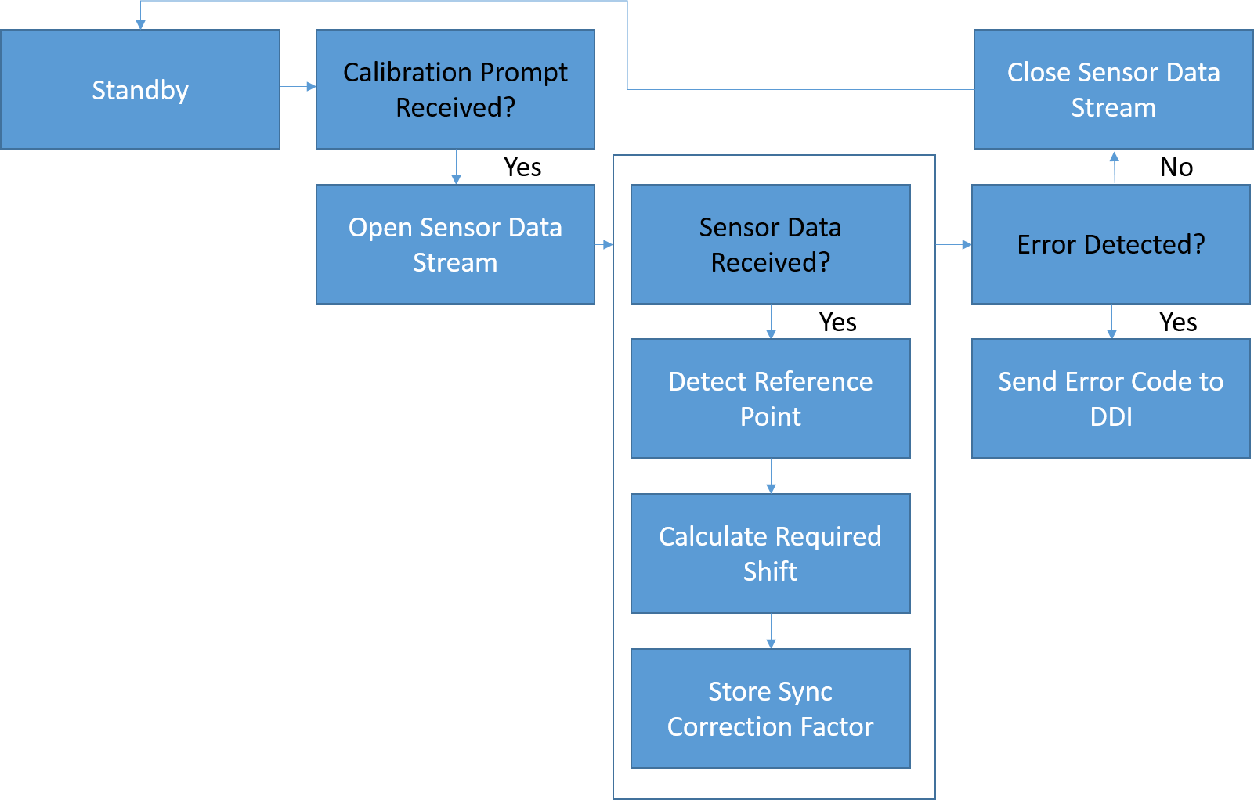
Synchronization Code

Slide 3
Current Program

Slide 4
Process
Loops to find maximum element in List
Stores timestamp value corresponding to max
Determines correction factor based on timestamps
If statements determine what is delayed
Reads out

Slide 5
Calibration Application
Read in Stationary Data
Read in Motion Data
Noise Filtering
Noise Filtering
Offset Calculation
Store Offset Value
Offset Application
Integrate
Gives Angular Position

